Slide 1
SpaceY by Allon Musk
Source: https://since1969.tumblr.com/post/45467723502
IBM Data Science Professional Certificate Capstone Project
Presented by Alimul Ferdous
9/20/2022

Slide 2
Executive Summary
The objective is to evaluate the viability of the new company SpaceY to compete with SpaceX. The best way to estimate the total cost for launches is by predicting successful landings of the first stage of rockets; Including best place to make launches.

Slide 3
Table of Contents
Introduction Slide# 4
Data collection and data wrangling methodology Slide# 6
EDA and interactive visual analytics methodology Slide# 7
Predictive analysis methodology Slide# 9
EDA with visualization results Slide# 12
EDA with SQL results Slide# 18
Interactive map with Folium Slide# 22
Plotly Dash dashboard Slide# 25
Predictive analysis (classification) Slide# 30
Conclusion Slide#

Slide 4
Introduction
Data Collection using scraping and SpaceX API, Exploratory Data Analysis (EDA), including data wrangling, data visualization, interactive visual analytics, and machine learning prediction.
It was possible to collect valuable data from public sources; EDA allowed us to identify which features are the best to predict the success of launchings; Machine learning prediction showed the best model to predict which characteristics are important to drive the opportunity in the best way, using collected data. The objective is to evaluate the viability of the new company Space Y to compete with Space Y.

Slide 5
Methodology
Data Collection – Data from SpaceX was obtained from SpaceX API and Web scrapping.
Data Wrangling – Collected data was enriched by creating a landing outcome label based on outcome data after summarizing and analyzing features
Perform exploratory data analysis(EDA) using visualization and SQL.
Perform interactive visual analytics using Folium and Plotly Dash.
Perform predictive analysis using classification models.

Slide 6
Data collection and Data wrangling Methodology
Collect and make sure data is in the correct format form an API
Data from SpaceX was obtained from 2 source
Space X API (https://api.spacexdata.com/v4/rockets/)
WebScrapping (https//en.Wikipedia.org/wiki/List_ofFalcon/_9/_and_Falcon_Heavy_lanches)
Clean the requested data
Exploratory Data analysis using visualization and SQL
Determine Training Labels

Slide 7
EDA and interactive visual analytics Methodology
Understand the SpaceX DataSet
Load the dataset into the corresponding table in a Db2 database
Execute SQL queries to answer assignment questions
Perform exploratory Data Analysis and Feature Engineering using `Pandas` and `Matplotlib`
Exploratory Data Analysis
Preparing Data Feature Engineering

Slide 8
Interactive Visual Analytics and Dashboard Methodology
Geographical patterns about launch sites
Visualized the SapceX launch dataset using matplotlib and seaborn.
Interactive visual analytics using Folium
Data visualization with cufflinks

Slide 9
Predictive Analysis Methodology
Perform exploratory Data Analysis and determine Training Labels
Create a column for the class
Standardize the data
Split into training data and test data
Find the best Hyperparameter for SVM, Classification Trees, and Logistic Regression
Find the method that performs best using test data

Slide 10
Result
Exploratory data analysis results:
Space X uses 4 different launch sites
The first launches were done to SpaceX itself and NASA
The average payload of the F9 v1.1 booster is 2,928kg
The first syces landing outcome happened in 2015 five years after the first launch
Many Falcon 9 booster versions were successful at landing in drone ships having payloads above the average
Almost 100% of mission outcomes were successful
Two booster versions failed at landing on drone ships in 2015: F9 v1.1 B1012 and F9v1.1 B1015
The number of landing outcomes became as better as years passed.

Slide 11
Result
Exploratory data analysis results:
Space X uses 4 different launch sites
The first launches were done to SpaceX itself and NASA
The average payload of the F9 v1.1 booster is 2,928kg
The first syces landing outcome happened in 2015 five years after the first launch
Many Falcon 9 booster versions were successful at landing in drone ships having payloads above the average
Almost 100% of mission outcomes were successful
Two booster versions failed at landing on drone ships in 2015: F9 v1.1 B1012 and F9v1.1 B1015
The number of landing outcomes became as better as years passed.
Using interactive analytics was possible to identify that launch sites use to be is safe places, near the sea, for example, and have a good logistic infrastructure around.
Most launches happen at east cost launch sites.
Predictive analysis showed that the Decision Tree classifier is the best model to predict successful landings, having an accuracy of over 87% and an accuracy for test data over 94%.

Slide 12
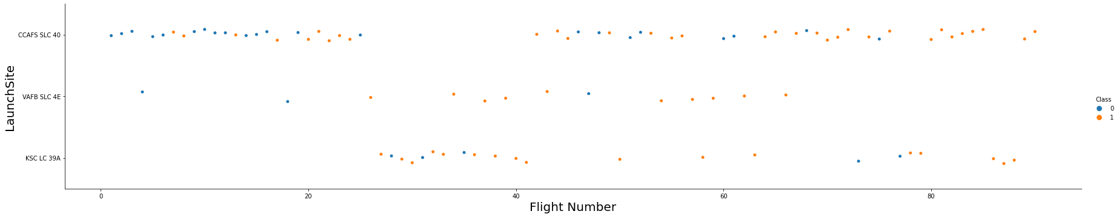
EDA with visualization results
Visualize the relationship between Flight Number and Launch Site

Slide 13
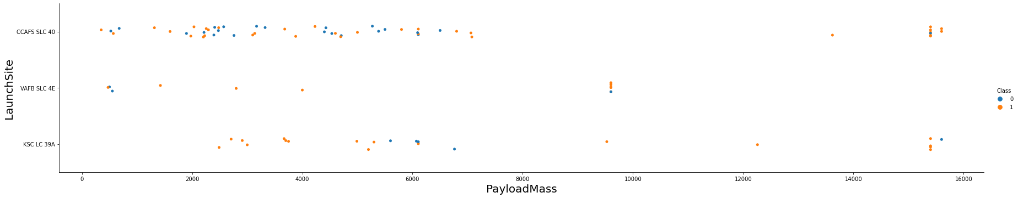
EDA with visualization results
Visualize the relationship between Payload and Launch Site

Slide 14
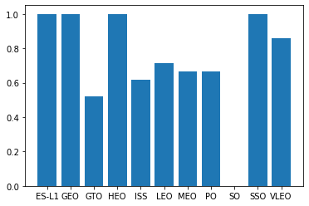
EDA with visualization results
Visualize the relationship between success rate of each orbit type

Slide 15
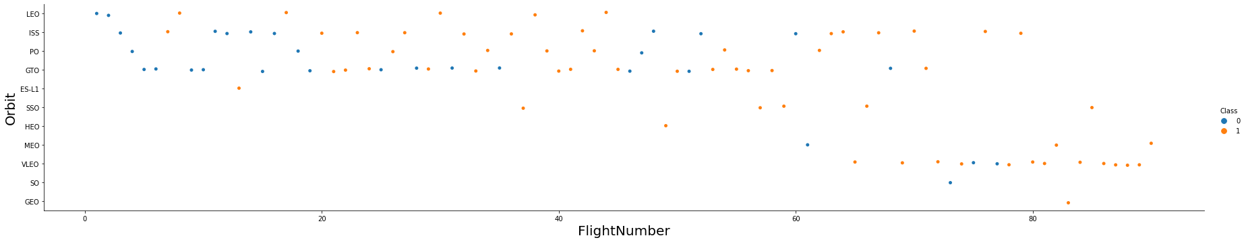
EDA with visualization results
Visualize the relationship between FlightNumber and Orbit type

Slide 16
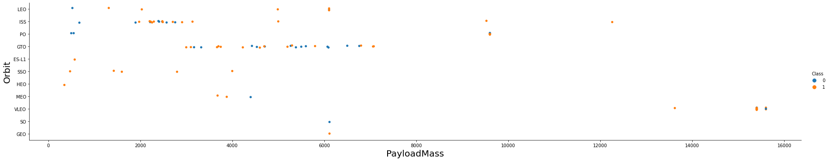
EDA with visualization results
Visualize the relationship between Payload and Orbit type

Slide 17
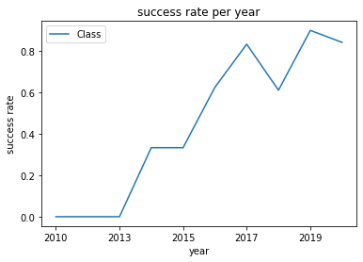
EDA with visualization results
Visualize the launch success yearly trend

Slide 18
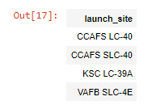
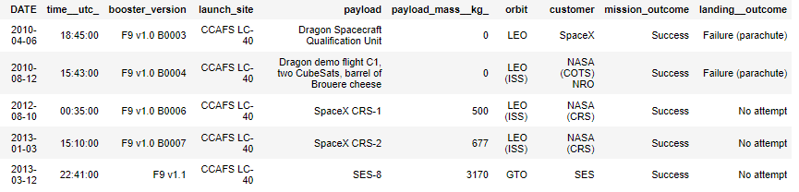
EDA with SQL results
The names of the unique launch sites in the space mission
5 records where launch sites begin with the string 'CCA'

Slide 19



EDA with SQL results
The total payload mass carried by boosters launched by NASA (CRS)
The date when the first successful landing outcome in the ground pad was achieved.
The names of the boosters which have success in drone ships and have payload mass greater than 4000 but less than 6000

Slide 20

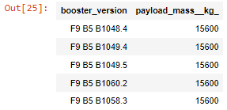
EDA with SQL results
The total number of successful and failed mission outcomes
The names of the booster_versions which have carried the maximum payload mass

Slide 21

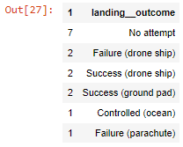
EDA with SQL results
The failed landing_outcomes in drone ship, their booster versions, and launch site names for in year 2015
Rank the count of landing outcomes (such as Failure (drone ship) or Success (ground pad)) between the date 2010-06-04 and 2017-03-20, in descending order

Slide 22
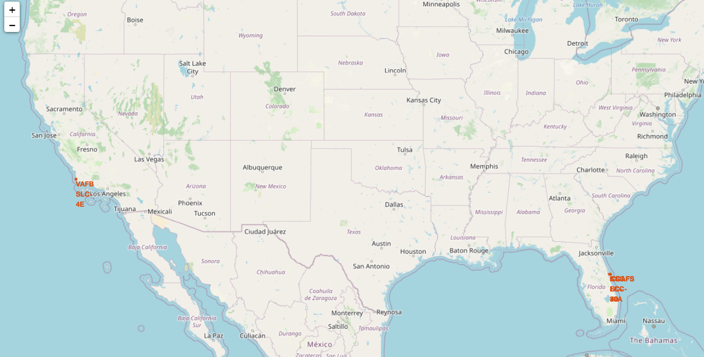
Interactive map with Folium results
All launch sites on a map

Slide 23
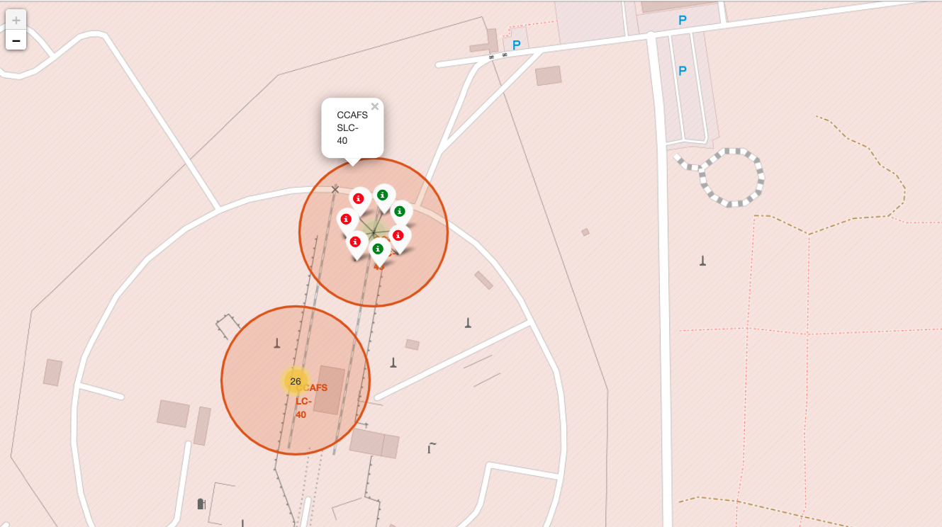
Interactive map with Folium results
The success/failed launches for each site on the map

Slide 24
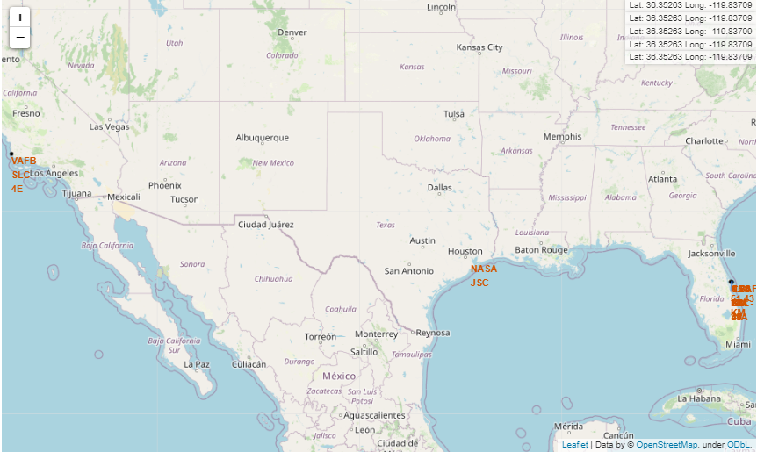
Interactive map with Folium results
The distances between a launch site to its proximities

Slide 25
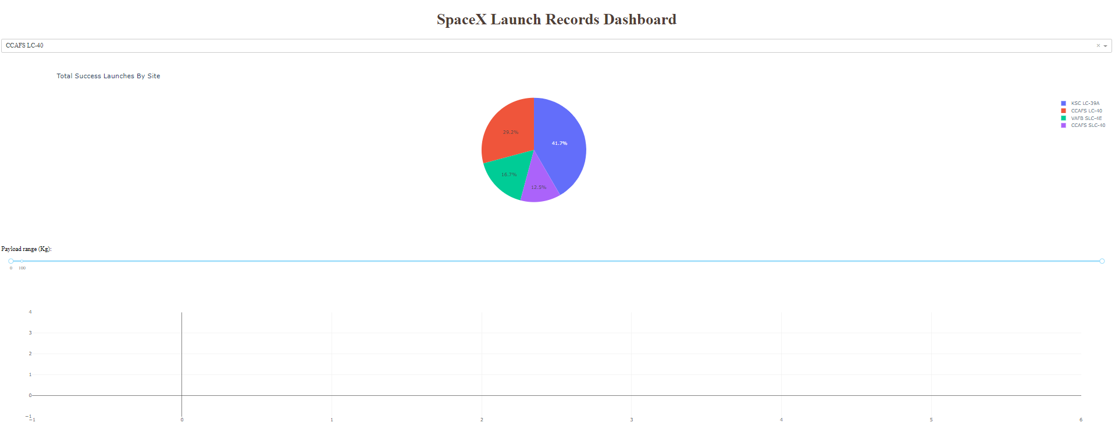
Plotly Dash dashboard results

Slide 26
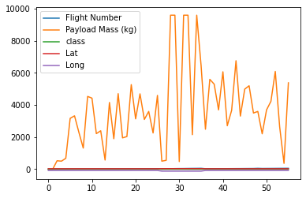
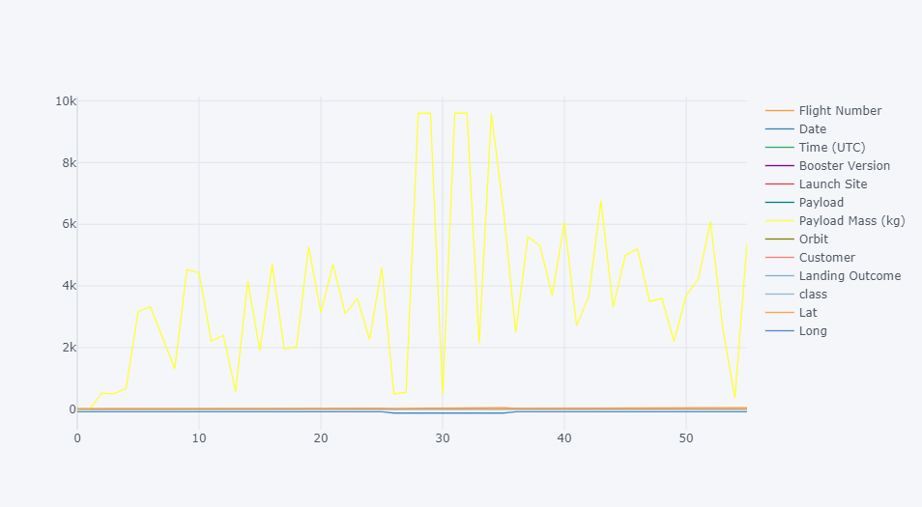
Plotly with Cufflinks results

Slide 27
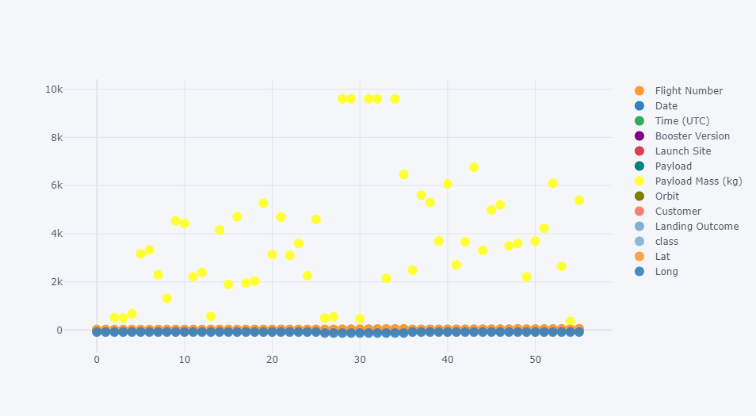
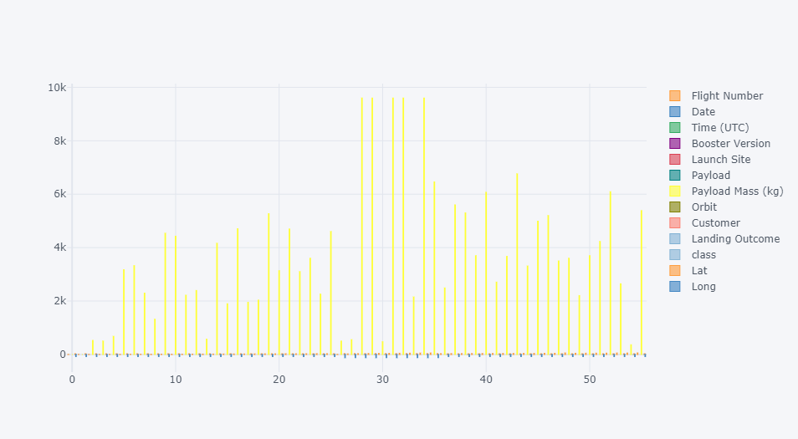
Plotly with Cufflinks results

Slide 28
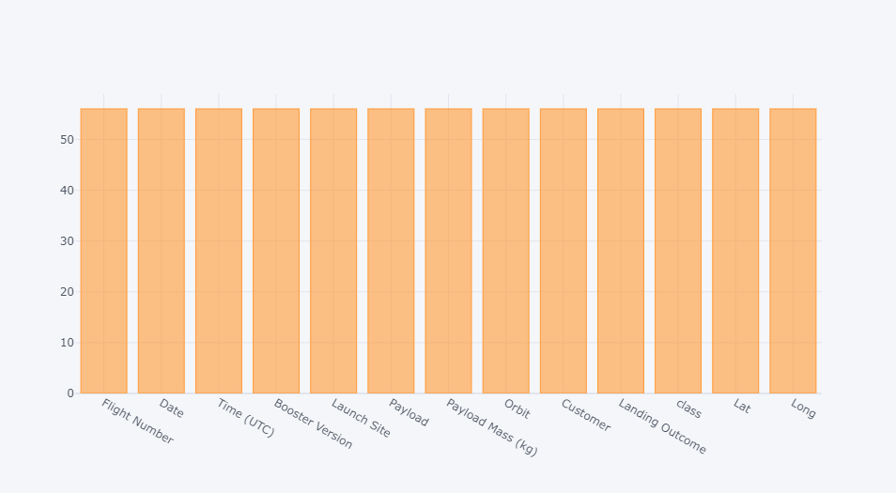
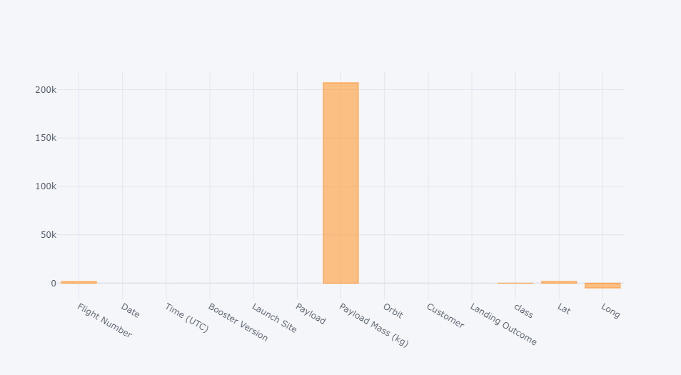
Plotly with Cufflinks results

Slide 29
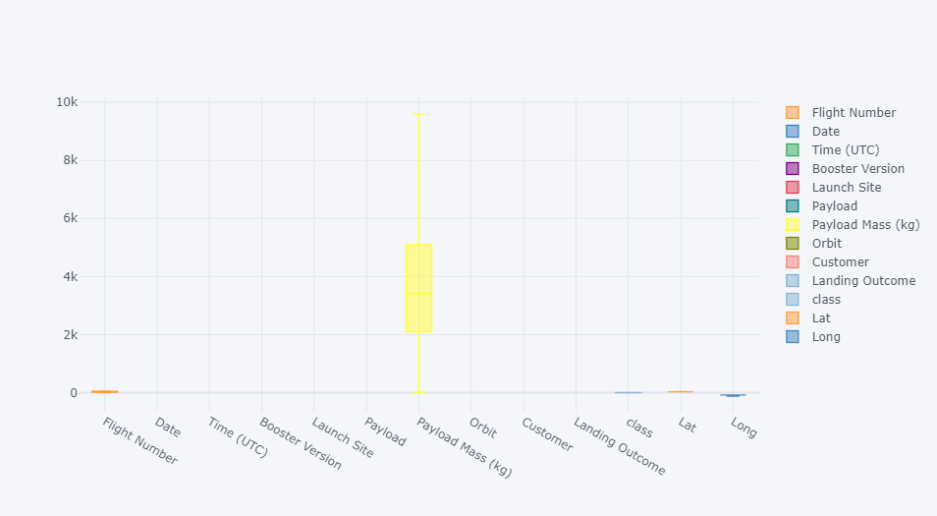
Plotly with Cufflinks results

Slide 30
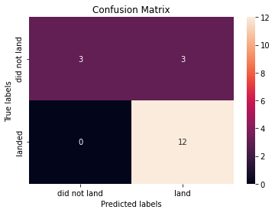
Predictive analysis (classification) results
The accuracy of the test data using the method score confusion matrix (GridSearchCV)

Slide 31
Predictive analysis (classification) results
The accuracy of the test data using the method score confusion matrix (svm_cv)

Slide 32
Predictive analysis (classification) results
The accuracy of the test data using the method score confusion matrix (tree_cv)

Slide 33
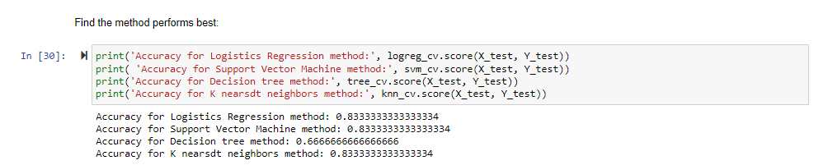
Predictive analysis (classification) results

Slide 34
Discussion
The larger the flight amount at a launch site, the greater the success rate at a launch site.
Launch success rate started to increase from 2013 till 2020.
Orbits ES-L1, GEO, HEO, SSO, VLEO had the most success rate.
KSC LC-39A had the most successful launches of any site.
The decision tree classifier is the best machine learning algorithm for this task.

Slide 35
Conclusion
In conclusion, we can say The larger the flight amount at a launch site, the greater the success rate at a launch site. The launch success rate started to increase from 2013 till 2020. Orbits ES-L1, GEO, HEO, SSO, and VLEO had the most success rate. KSC LC-39A had the most successful launches of any site. The decision tree classifier is the best machine learning algorithm for this task.

Slide 36
Appendix
Discussion
Link
https://github.com/alimulferdous27/SpaceY---IBM-Data-Science-Professional-Certificate-Capstone-Project.git

